Slide 1
Work Trauma
Michael Epstein

Slide 2
scope of this talk
work trauma encompasses all work related injury
focus on mental health injuries
aka psychiatric/psychological injury
‘stress claims’
a complex medical/social/political minefield
2 questions to be answered later
In 1987 the number of workers’ compensation claims by Victoria Police dropped by 50% - why?
1993 the number of Victorian ‘stress claims’ dropped from a decade long 5.2% of all claims to 2.5% of all claims why?
we will examine the data – and its flaws!
some strategies to reduce mental health injuries

Slide 3
What is work trauma?
Work trauma is any work related incident or injury.
Work trauma can be due to physical injury, mental injury or a combination of both.
Work trauma has led to the development of the various workers compensation schemes. Each state has different scheme - there are four Commonwealth schemes.
Statistics about the various workers compensation schemes and the frequency and cost of work trauma are collated annually by Safe Work Australia: focusing on serious claims
https://www.safeworkaustralia.gov.au/

Slide 4
what is an ‘injury’?
In Victoria the Workplace Injury Rehabilitation and Compensation Act (WIRCA)
provides the following definition
“Injury” means any physical or mental injury and, without limiting the generality of that definition, includes—
(a) industrial deafness; and
(b) a disease contracted by a worker in the course of the worker’s employment (whether at, or away from, the place of employment); and
(c) a recurrence, aggravation, acceleration, exacerbation or deterioration
of any pre-existing injury or disease;

Slide 5
material contribution
work has to have materially contributed to the injury.
the work injury need not be the sole, or even principal, cause of the damage, although it must have materially contributed to it.
the previous Act used the term ‘significant contributing factor’ that appears synonymous with material contribution
this meant that employment must have contributed to the injury in a way that is not insignificant, trivial or minimal.
factors assisting include:
duration of employment
nature of the work
particular tasks involved
would the injury have occurred anyway
other factors including lifestyle, non work activities, hereditary risks

Slide 6
a serious claim
A serious claim is for an injury that results in at least 5 days off work ( in Victoria for 10 days)

Slide 7
Causes of work trauma - inherent in the job
injury – defence force/police/prison officers/firefighters/miners timber workers/construction workers/ truck drivers
occupational diseases – meat workers/ health workers/agricultural workers
long or irregular hours – police/doctors/paramedics/chefs/managers
repetitive work – factory workers/clerks/cleaners
distasteful work – prison officers/paramedics/meat workers/police/personal carers
isolation – artist/writers/composers/clergy/
shift work – factory workers/FIFO/police/paramedics/prison officers
difficult client population – police/prison officers/social workers/WorkCover agents/psychiatrists
performers – theatre/musicians/sports people
helpers – PCAs/Home help/paramedics/firefighters
vicarious trauma – paramedics/ police officers

Slide 8
work trauma not inherent in the job
redtape – police/managers/public servants/ school principals
conflicting demands – clergy/social workers/union workers
lack of autonomy – police/defence force/cottage parents
low public image – parking officers/politicians/psychiatrists
no security – defence force/small business people/performers/farmers
disillusionment – clergy/social workers/police/paramedics
work overload – small business people/firefighters
bullying & harassment – factory workers/disability workers/hospitality workers

Slide 9
workforce 7/2017 – 6/2018 (ABS) rate of injury
13.4 million in the workforce
4.2% of workforce(536,000) had a work injury or disease
158,935 serious claims
serious claims rate 1.2% of the workforce
and 30% of all work injury or disease.
“stress” claims about 6.2% of all serious claims
0.07% of the workforce
approx. 9800 claims

Slide 10
work trauma – total cost to the Australian economy SafeWork Aust. 2012-2013
In 2012–13, work-related injury and disease cost the Australian economy $61.8 billion, representing 4.1% of GDP.
$480 million paid in workers’ compensation each year for work related mental disorders
Total cost to the community of work related mental disorders $3.1b

Slide 11
absences from work - 2017-2018
563,600 persons work injury or illness 2017-2018
_{40% (221500) no time off work}
_{28% sustained a sprain/strain}
_{20% sustained a cut/open wound}
15% sustained a chronic joint or muscle condition
60% (338,160) some time off work.
_{53% (179,224) 4 days or less}
47% (158,935) 5 days or more (serious claim)

Slide 12
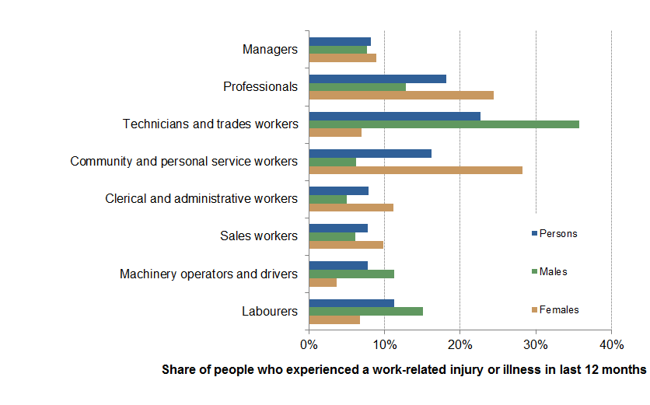
%age work injury or illness, occupation groups and sex

Slide 13
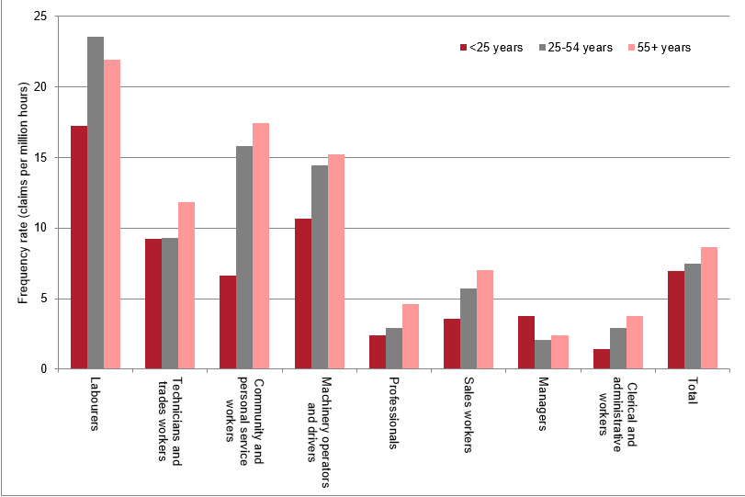
%age claims by occupation/age

Slide 14
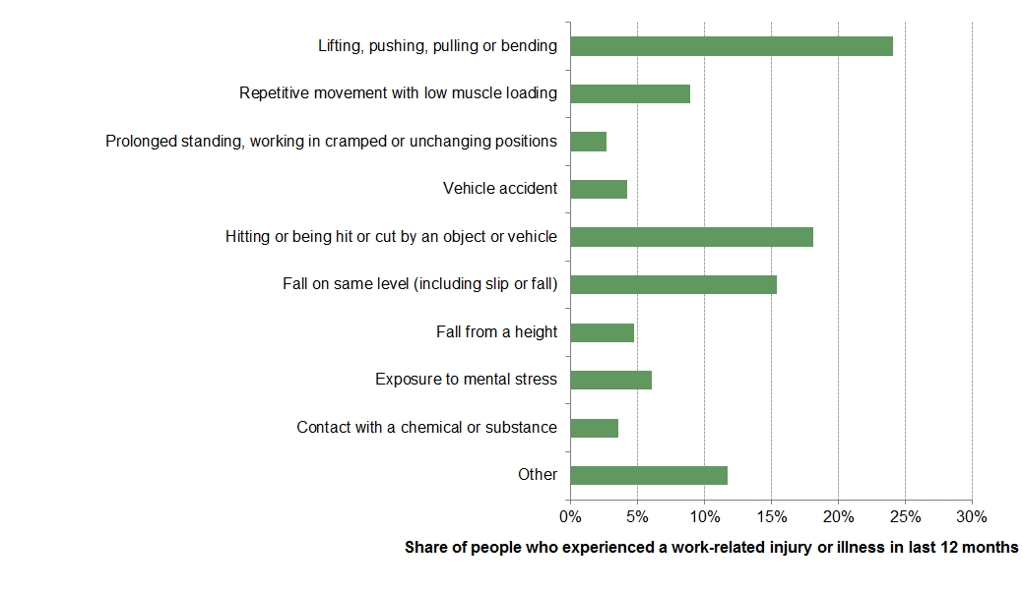
Mechanism of injury/illness 2017-2018

Slide 15
Comparison 2006-2007 and 2015-2016
time lost for a serious claim h32% from 4.4 weeks g 5.8 weeks
compensation paid h 39% from $6200 g $8600 (however average weekly earning increased by 46% over this period)
serious claims per million hours worked i 28%

Slide 16
Work Stress
What causes it?
What are the effects?
‘Stress’ claims
What is the cost?
How do governments try to reduce the cost of these claims?

Slide 17
causes of work stress
high job demand
low job demand
poor support
poor workplace relationships
low role clarity
poor organizational change management
poor organizational justice
poor environmental conditions
remote or isolated work, and
violent or traumatic events.

Slide 18
effects of work place ‘stress’
work-related stress linked with :
unplanned absences including sick leave
staff turnover
withdrawal and presenteeism (at work but less productive)
poor work and poor product quality
mental health issues.

Slide 19
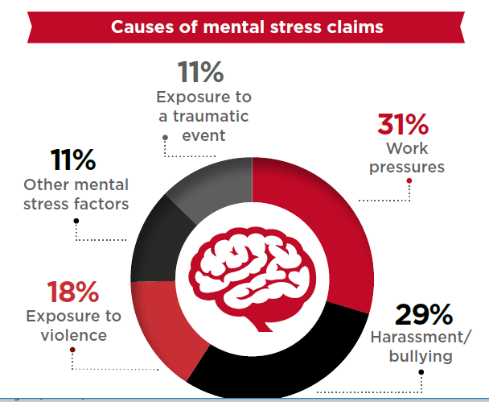
SafeWork Australia 2016-2017

Slide 20
claims accepted/ not accepted 2017-2018

Slide 21
%age accepted total v ‘stress claims 2016-2017

Slide 22
Safe Work Australia stress claims accepted: 2011/2012 g 2016/2017 workforce numbers 2011:11,440,000g2016:11,930,000 % increase 4.3%

Slide 23
percentage of mental health claims by gender vs all serious claims

Slide 24
‘stress injuries’ 2017-2018 (by gender) - compared with sprains/strains

Slide 25
Occupational groups with the highest rate of claims for mental health conditions (SWA)

Slide 26
specific jobs with highest claim rate mental health conditions

Slide 27
median direct cost various ‘stress claims

Slide 28
Mental health conditions vs all serious claims – weeks off work

Slide 29
percentage cost increase stress/all claims vs increase in AWE

Slide 30
%age change compensation paid 2000/2001 – 2015/2016 vs weekly earnings

Slide 31
Overall, frequency rate of stress claims
Claims/100 million hours re mental stress claims fallen 2005-06 and 2015-16.
0.51 claims/million hours (2005-2006) g 0.43 claims/million hours (2015-2016)
While the rate for harassment and/or bullying claims has increased over that same period, it has been trending down since the peak in 2010-11.
Australian Bureau of Statistics Work-related Injuries Survey 2013–14 report
60 % of employees reported mental stress but did not apply for workers’ compensation.

Slide 32
Bullying and Harassment
Bullying as defined in the Fair Work Act has three distinct characteristics
unreasonable behaviour
repeated
that behaviour creates a risk to health and safety.
2016 - 9.6 % employees experienced bullying within a six-month period.
The 2014 Workplace Bullying in Australia report
41.6 per cent of Australian employees experience bullying at some time in their working life.

Slide 33
number of claims by occupation re bullying/harassment

Slide 34
industries with higher rates of claims involving work-related harassment/ bullying

Slide 35
Occupations - higher rates of claims re bullying/harassment.
school teachers
health and welfare support workers
personal carers and assistants
nursing professionals
defence force members
firefighters
Police
These occupations involve
high levels of interaction with other people
rendering a service to the public sometimes in difficult and challenging circumstances.

Slide 36
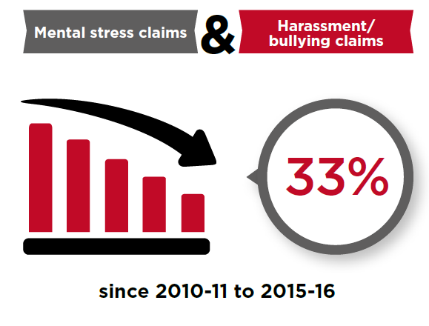

Slide 37
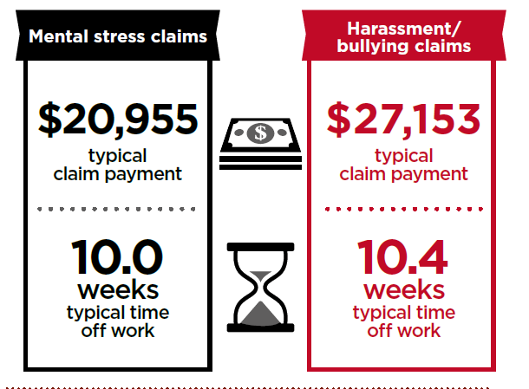

Slide 38
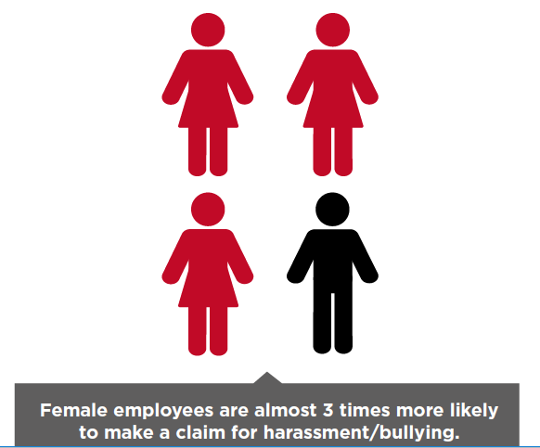

Slide 39
lies, damn lies and statistics
Fundamental problems with SafeWork statistics
No account taken of the prevalence of mental and behavioural conditions in Australia.
No account of the issue of co-morbidity

Slide 40
proportion of Australians with a mental or behavioural condition 2017-2018

Slide 41
proportion of persons with anxiety

Slide 42
proportion of persons with depression

Slide 43
mental or behavioural condition and work

Slide 44
ABS statistics vs. Safe Work statistics
2017-18, 1 in 5 (20.1%) or 4.8 million had a mental or behavioural condition
more common amongst females than males (22.3% compared with 17.9% respectively).
Almost 1 in 3 (30.0%) females 15-24 years had a mental or behavioural condition and 1 in 5 (21.3%) males 15-24 years.
In 2017/2018 there were 34,000 work claims for mental or behavioural disorders (only about 5,000 claims accepted).
In 2017-2018 there were 13.4 million in the workforce.
ABS data indicates that in 2017-2018, 60% of those with mental or behavioural conditions were in the workforce, about 2.88 million.
what proportion of those with a work claim for a mental or behavioural condition had a condition unrelated or only peripherally related to employment?

Slide 45
on the other hand - co-morbidity
SafeWork Australia statistics do not measure co-morbidity

Slide 46
musculoskeletal conditions and comorbidity Australian Institute of Health and Welfare 2014-15
Almost 4 in 5 (79%) people with arthritis and 2 in 3 (65%) people with back pain and problems had at least 1 other chronic condition.

Slide 47
arthritis

Slide 48
back pain

Slide 49
estimates of work related co-morbidity
2016-2017 serious claims for back injury – 15,275
co-morbidity mental/behavioural condition (30%) 4,582
2016-2017 sprains/strains, serious claims 56,400
co-morbidity mental/behavioural condition (10%) 5,600
number of mental/behavioural conditions accepted 5,200
guesstimate of work mental/behavioural condition >15,000

Slide 50
flawed statistical survey
Safe Work Australia statistics both:
over-estimate work related mental/behavioural conditions
no account taken of ABS data re prevalence of mental/behavioural condition in the community
under-estimate work related mental/behavioural conditions
no attempt to measure co-morbidity with work related mental/behavioural conditions

Slide 51
issues for workers with a work related mental/behavioural conditions
continuing stigma about admitting to a mental/behavioural condition
resentment from employers and co-workers about time off work due to a mental/behavioural condition
a mental/behavioural condition is a central narcissistic wound, it implies:
weakness
failure
inadequate when compared with co-workers
credibility concerns, am I believed?
lack of a clear time frame for recovery
treatment that may reinforce stigma eg seeing a psychologist/ taking tablets
traumatization from the workers’ compensation system (proving injury)

Slide 52
an example
An experienced Victorian police officer was shot, had a claim and was later ill health retired.
He told me “ In a funny way I was glad I was shot because I knew I couldn’t keep doing the job. My wife told me to see a psychologist but even now its not a good look.
“If I hadn’t been shot I would have had to make a stress claim. I would have found that humiliating and embarrassing, now I’m sort of a hero!”

Slide 53
discrimination by employers low RTW rate: employers view (analysis RTW results SafeWork November 2017)

Slide 54
low RTW rate: employees view

Slide 55
RTW - key influencing factors (1 November 2017)

Slide 56
discrimination against injured workers with a mental health condition
most jurisdictions (except for Northern Territory,Queensland and Commonwealth)
impairment benefits only for non secondary impairment or ‘pure mental harm’
different thresholds for permanent impairment physical/ mental/behavioural disorders in some states
all exclude ‘stress’ claims due to ‘reasonable management action’
In South Australia and Queenskand work has to be the significant contributing factor for a mental/behavioural injury but not for physical injury

Slide 58
1st National Data about mental health Police and Emergency services (Dr Sam Harvey et al - Black Dog Institute)
N = 21,014
1 in 10 current employees – probable PTSD
1 in 4 former employees – probable PTSD
worked > 10 years 2x likely to have ‘stress’
poor workplace practices;
“as damaging to mental health as occupational trauma”

Slide 59
mental health of current and retired fire fighters in NSW Harvey SB et al ANZ J Psych 2016 50(7) 649-658

Slide 60
impact of cumulative trauma exposure fire-fighters in NSW (Black Dog Institute)

Slide 61
manager behaviour and mental health symptoms (K6 questionnaire)

Slide 62
how various non-trauma workplace risk factors may interact

Slide 63
how various non-trauma workplace risk factors may interact

Slide 64
how various non-trauma workplace risk factors may interact

Slide 65
how various non-trauma workplace risk factors may interact

Slide 66
Evidence based framework-healthy workplace (Black Dog Institute)

Slide 68
2 questions
In 1987 the number of workers’ compensation claims by Victoria Police dropped by 50% - why?
An enhanced Emergency Services Superannuation Scheme emerged –
result – Victoria Police claiming ESSS h by 250%
1993 the number of Victorian ‘stress claims’ dropped from a decade long 5.2% of all claims to 2.5% of all claims why?
The Kennett government introduced S82(2a) rejecting claims due to reasonable management action

Slide 69
Conclusions
workplace injuries comprise about 1% of workforce each year
‘stress’ claims 6-7% of all claims
statistical overlap between ABS data and Safe Work data
The importance of co-morbidity not recognised in the statistics
all jurisdictions discriminate against injured workers with a mental health injury
‘stress claims’ lead to prolonged absence from work and a higher personal and community cost than other claims
certain occupations have a much higher rate of ‘stress claims’ because of:
the nature of the work
management issues
Evidence based research shows reduction in work place stress can occur by:
reducing stigma
resilience training
mentorship training
early recognition of distress and appropriate management action
supportive return to work after absence

